Slide 1
Dimensionality Reduction

Slide 2
Idea
High dimensional data sets require a lot of training data, and can lead to suboptimal fits
Data often has underlying structure, and is not randomly distributed across all dimensions

Slide 3
Curse of Dimensionality
Issues when dealing with high dimensional datasets
Training instances required to properly fit additional features scale exponentially with number of features
Feature space is very sparse, and new instances can be unlike previous instances

Slide 4
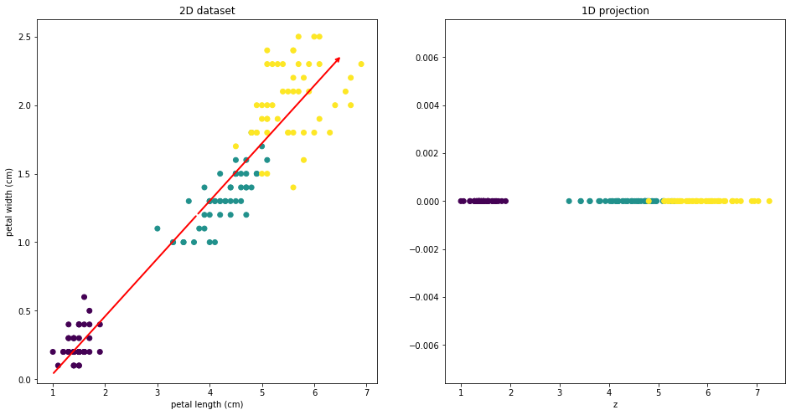
Reducing Dimensionality
Projecting
Project higher dimensional dataset onto a lower dimension
x, y -> z₁
z₁ is a coordinate axis in the projected plane

Slide 5
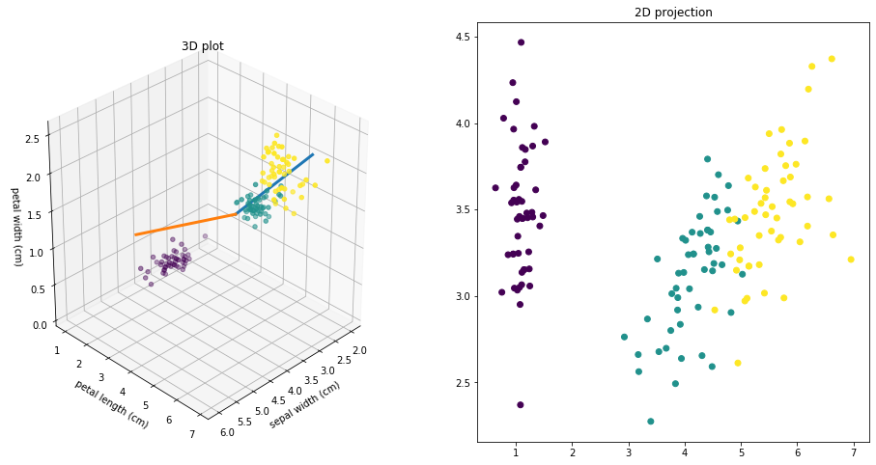
Reducing Dimensionality
Projecting
Project higher dimensional dataset onto a lower dimension
x, y, z -> z₁, z₂
z₁, z₂ are coordinate axes in the projected plane

Slide 6
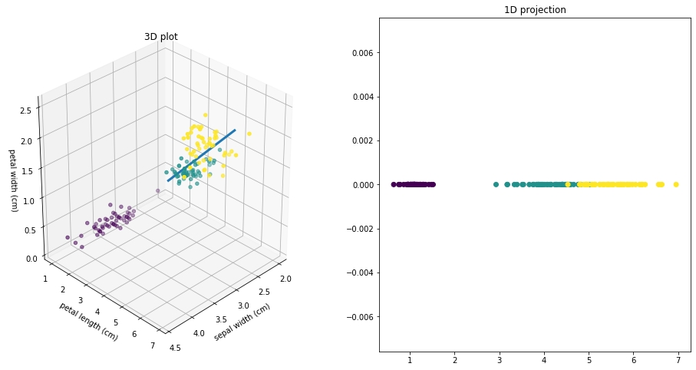
Reducing Dimensionality
Projecting
Project higher dimensional dataset onto a lower dimension
x, y, z -> z₁
z₁ is a coordinate axis in the projected plane

Slide 7
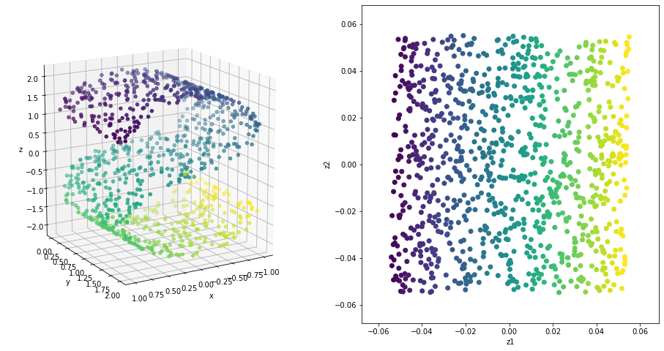
Reducing Dimensionality
Projecting
Manifold Learning

Slide 8
Reducing Dimensionality
Projecting
Manifold Learning
Manifold hypothesis - real world data is usually lives in a lower dimensional manifold that is embedded into the higher dimensional (feature) space

Slide 9
Reducing Dimensionality
Projecting
Manifold Learning
Manifold hypothesis
We can try to learn the manifold and reduce onto coordinates that define the manifold

Slide 10
Reducing Dimensionality
Projecting
Manifold Learning
Manifold hypothesis
Learn the manifold
Only useful if data behaviour in manifold is simpler than in original dimensions - try through experimenting

Slide 11
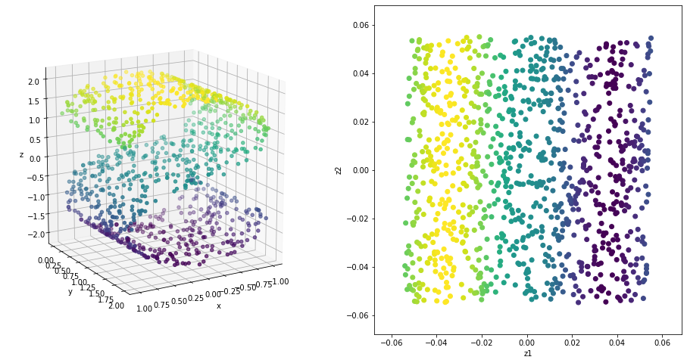
Reducing Dimensionality
Projecting
Manifold Learning
Manifold hypothesis
Learn the manifold
manifold is simpler than in original dimensions
In this case original dimension is simpler (values by z-height)

Slide 12
Why?
Can reduce computation times
Can result in better performing models due to less sparsity + possibly filtering out noise

